Slide 1
Some improved Stata ado files for nonparametric smoothing procedures
Isaías Hazarmabeth Salgado Ugarte
Laboratory of Biometry and Fisheries Biology
Facultad de Estudios Superiores Zaragoza
U.N.A.M.

Slide 2
Introduction I
In what follows I will present some improved ado files with routines that originally were written in a very simple manner.
Among these are included programs to calculate:
  density traces,
  practical rules for the number and width of bins in histograms and frequency polygons and bandwidth in kernel density estimation,
  direct and discretized variable bandwidth kernel density estimators,
  critical bandwidth finder and
  bootstrap to perform nonparametric multimodality assessment.

Slide 3
Introduction II
These improved ado files are simple too, but they are more versatile and more “Stata like” than the original versions besides adjusting some details from the previous versions.

Slide 4
Density traces I
Density traces were presented in:
Chambers, J.M., W.S. Cleveland, B. Kleiner and P.A. Tukey (1983) Graphical Methods for Data Analysis. Wadsworth & Brooks/Cole, Chap. 2: 9-46.

Slide 5
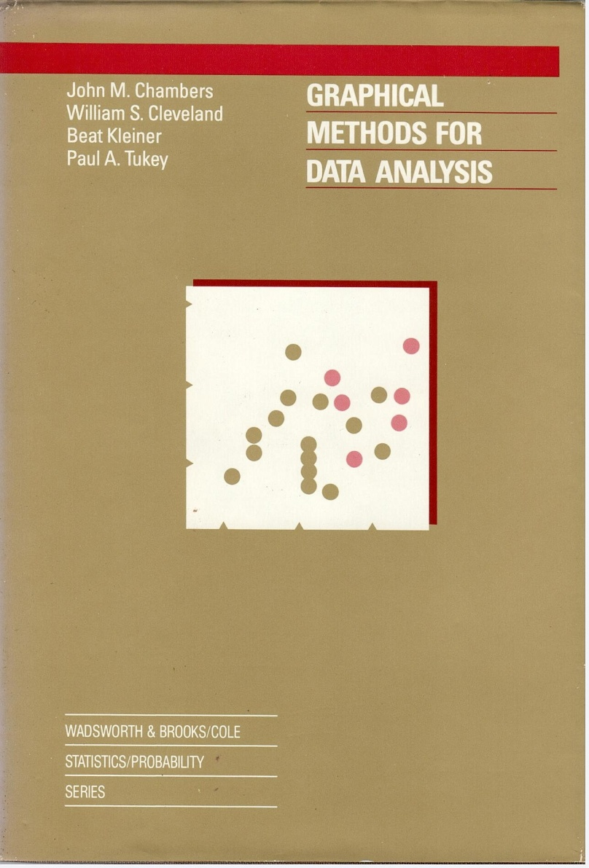
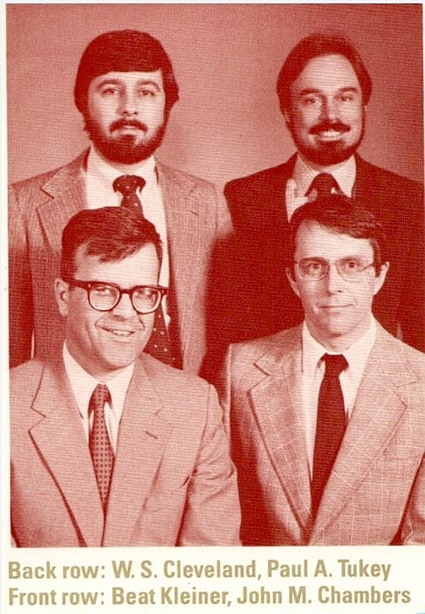
Density traces II

Slide 6
Density traces III
The ado files include:
  boxdent (boxcar weight function) using a direct algorithm and
  dentrace (boxcar and cosine weight functions) implemented with a discretized procedure

Slide 7
Density traces IV
boxdent.ado
This program calculates the density trace of a continuous variable using the boxcar weight function described in Chambers et al. (1983) and graph it.
This procedure performs conditional summaries for every observation in the data set. Thus, the time it requires is proportional to the quantity of data. Please be patient.

Slide 8
Density traces V
boxdent varname [if exp] [in range], hval(#) [gen(denvar) nograph graph_options]
Options:
hval is the constant specifying the window width around each data point. This value is required in order to run the procedure. If not specified, the program displays an error message and halts.
gen(denvar) permits to generate a new variable with the calculated density trace values.
nograph suppress the graphic display.
graph_options refers to any of the valid options of graph, twoway.
Similarly with boxdetra.ado, boxdent.ado carries out conditional summaries for each value in a data set. Therefore, the time required to complete calculations is related directly with the number of observations. Depending on your system velocity it may require for your patience.

Slide 9
. use ozone
. boxdent ozone, h(75) gen(dtrace)

Slide 10
. scatter dtrace ozone, c(l) ms(+)

Slide 11
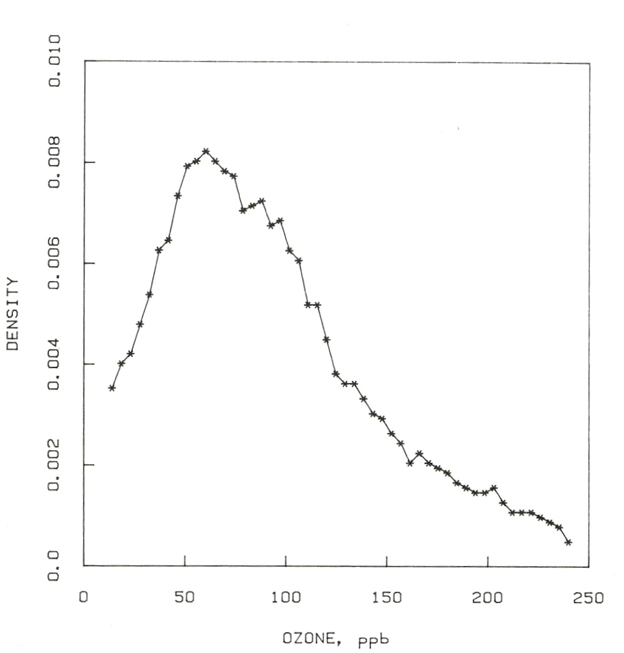
Figure 2.17 of Chambers, et al. 1983

Slide 12
Density traces IV
Differences:
  Boxdent:
    direct calculation algorithm (all the data points considered)
    Possible to combine with boxplots
    Time of calculation proportional to data points
  Chambers, et al.
    Discretized (50 grid points for calculations)
    Faster

Slide 13
Density traces V
dentrace.ado
This program calculates the density trace of a continuous variable using two weight functions (boxcar and cosine) as described in Chambers et al. (1983), and graph the results.

Slide 14
Density traces VI
dentrace varname [if exp] [in range] [, kcode(#) npoints(#) gen(denvar midvar) nograph graph_options]
Options
hval(#) permits to establish the window (band) width
fcode(#) permits to indicate the code for the weight function: 1 squared (boxcar); 2 cosine
npoints(#) it is used to specify the number of evenly spaced points used for estimation
gen is used to generate two new variables: “denvar” with the density values and “midval” containing the points considered for calculation.
nograph and graph_options as in boxdetra.ado.
hval and fcode are not optional. If not provided by the user, the program halts and display an error message on screen.
Even though dentrace considers for default only 50 equally spaced points, the time required for calculation is directly proportional to the number of observations. It may require your patience.

Slide 15
. dentrace ozone, h(75) f(1) gen(dtraceb midpt)

Slide 16
. scatter dtraceb midpt , c(l) ms(x)

Slide 17
. dentrace ozone, h(75) f(2) gen(dtracec midptc)

Slide 18
. dentrace ozone, h(25) f(2)

Slide 19
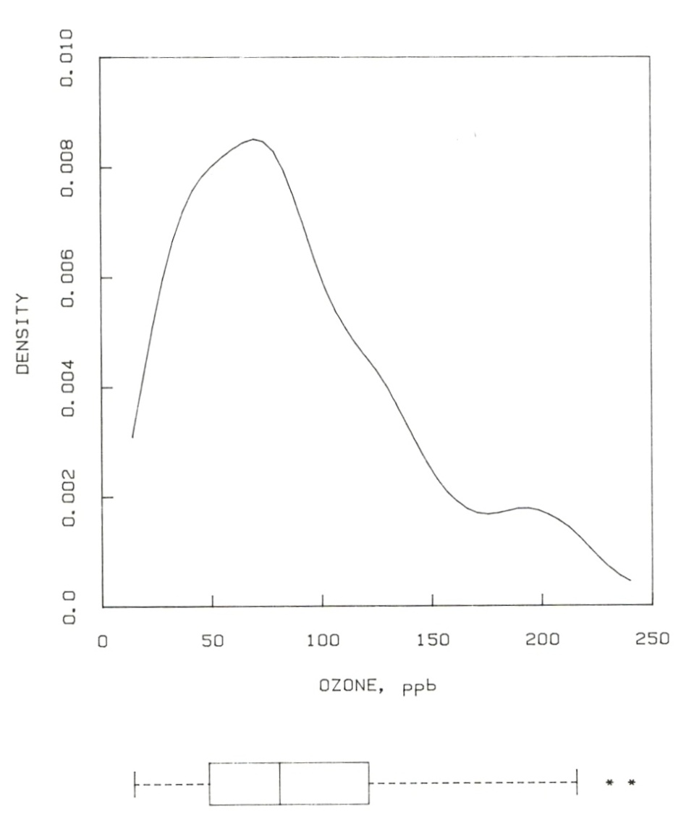
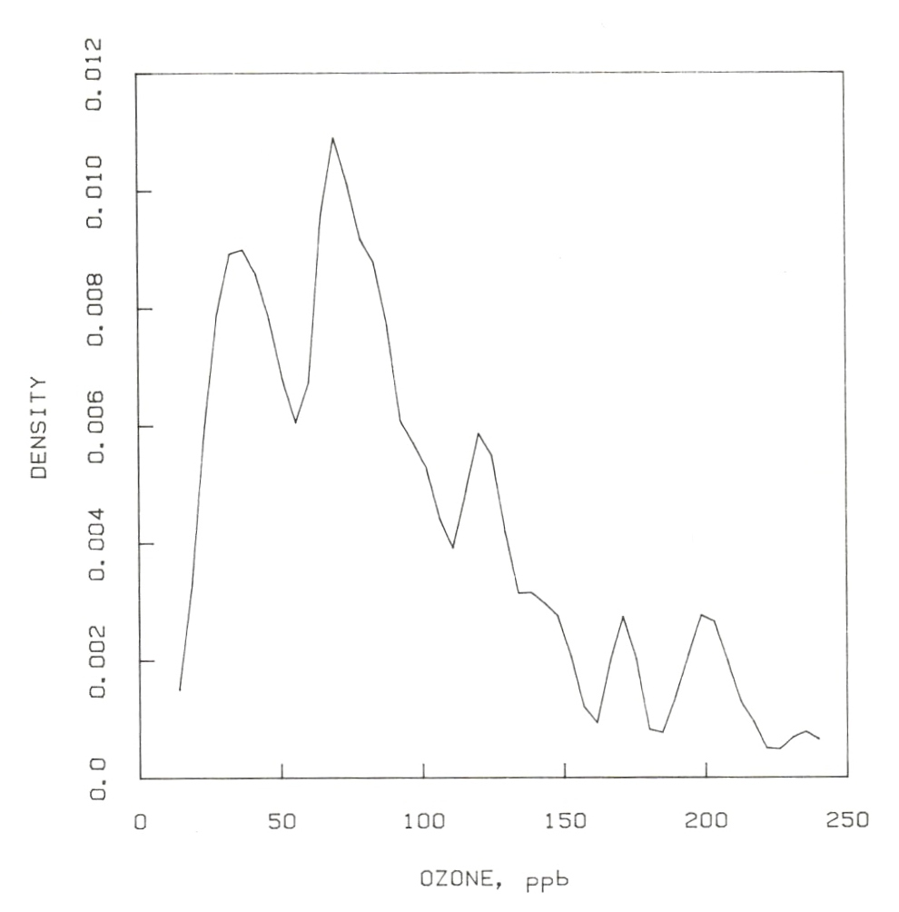
Figs. 2.20 and 2.21 Chambers, et al. 1983

Slide 20
Bandwidth choice I
In kernel density estimation, one very important step is the bandwidth choice. As previously published, bandw.ado calculates a collection of rules for choosing the bin number or width (histograms and frequency polygons) or bandwidth (kernel density estimators).

Slide 21
Bandwidth choice I
This improved version of bandw.ado permits to choose the kernel and to adjust automatically the oversmoothed and optimal bandwidths according to the conversion tables included in Härdle (1991), Scott (1992) and Salgado-Ugarte et al. (1995b).
All the rules based on the equations included in Silverman (1986), Fox (1990), Haerdle (1991), Scott (1992) and Salgado-Ugarte (2002).

Slide 22
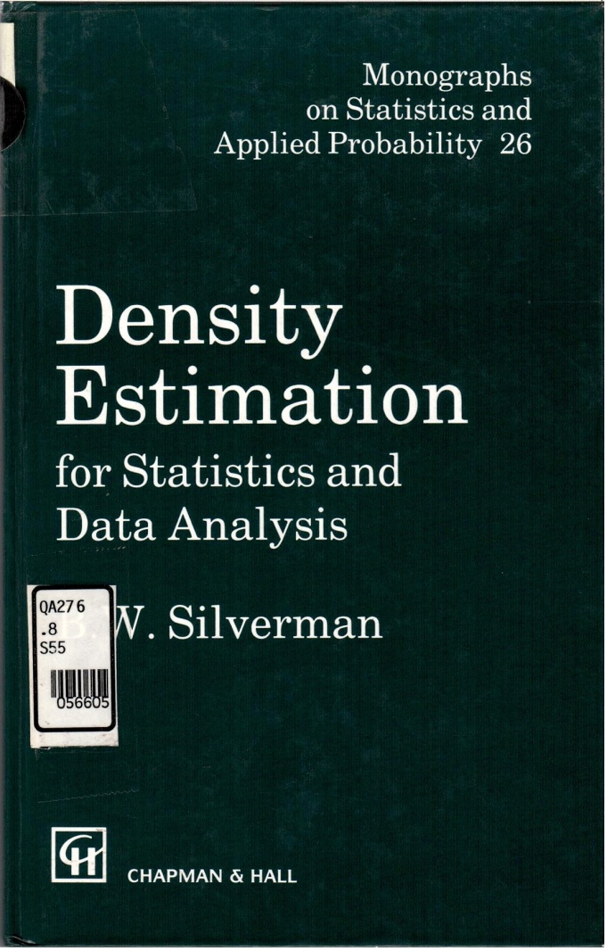
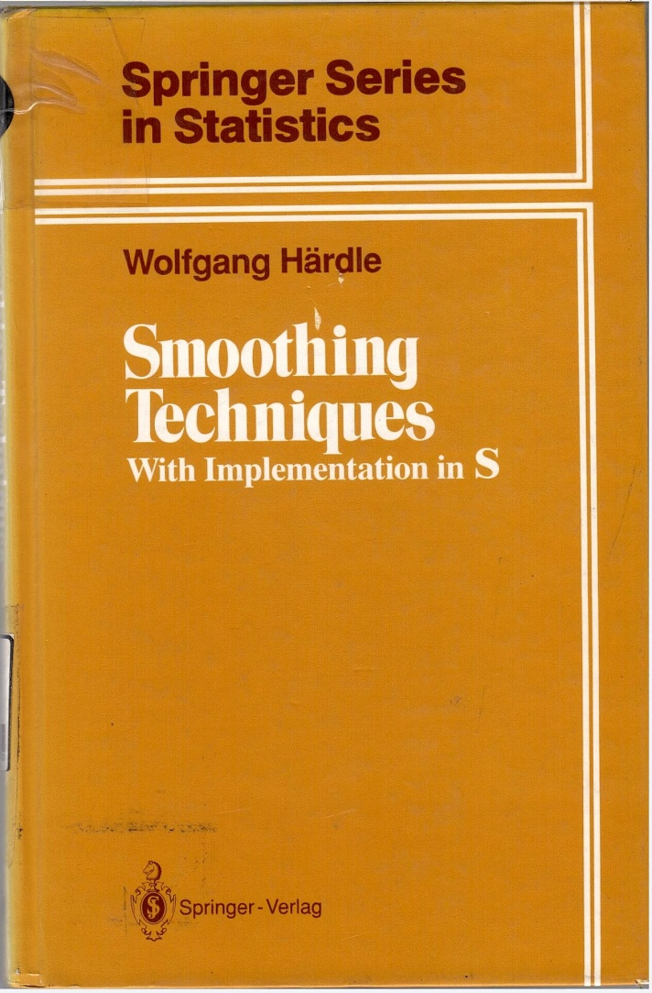
Bandwidth choice Ia

Slide 23
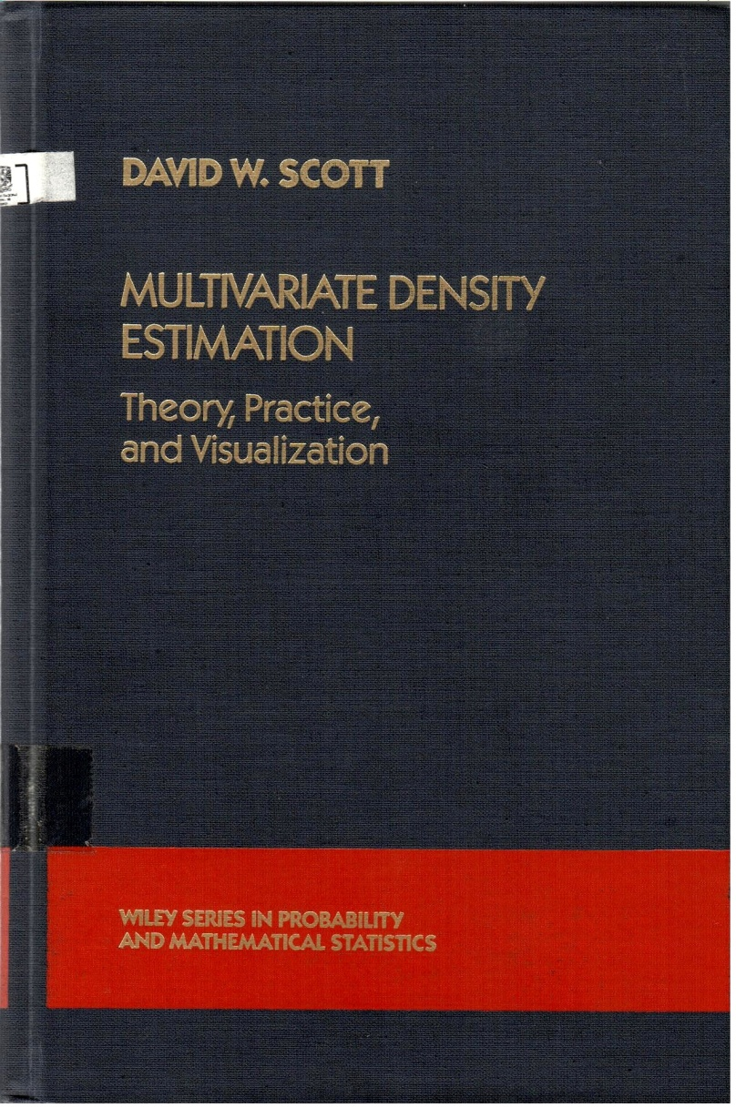
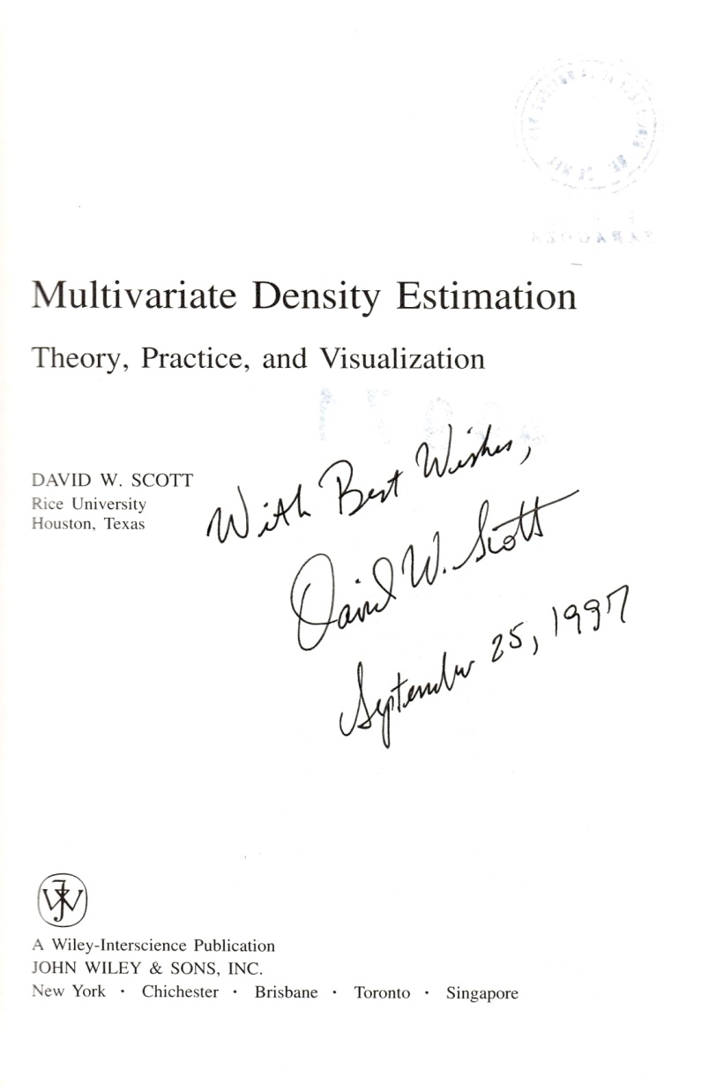
Bandwidth choice Ib

Slide 24
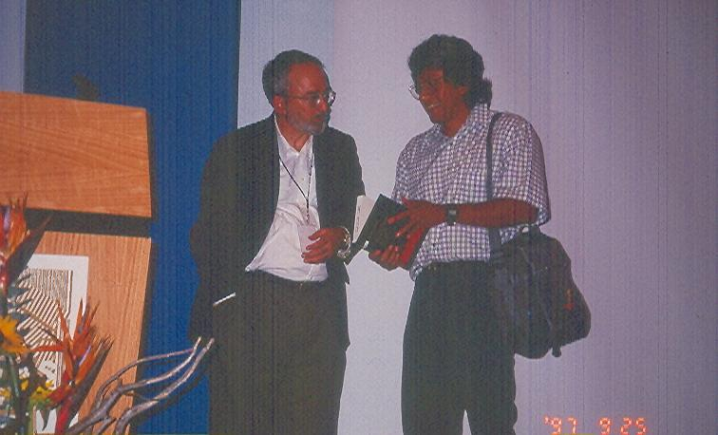
Bandwidth choice Ic

Slide 25
Bandwidth choice II
Some conversion factors for common kernels
to/from | Uniform | Triangle | Epanech. | Quartic | Triweight | Cosinus | Gaussian
Uniform | 1.000 | 0.715 | 0.786 | 0.663 | 0.584 | 0.761 | 1.740
Triangle | 1.398 | 1.000 | 1.099 | 0.927 | 0.817 | 1.063 | 2.432
Epanech. | 1.272 | 0.910 | 1.000 | 0.844 | 0.743 | 0.968 | 2.214
Quartic | 1.507 | 1.078 | 1.185 | 1.000 | 0.881 | 1.146 | 2.623
Triweight | 1.711 | 1.225 | 1.345 | 1.136 | 1.000 | 1.302 | 2.978
Cosinus | 1.315 | 0.941 | 1.033 | 0.872 | 0.768 | 1.000 | 2.288
Gaussian | 0.575 | 0.411 | 0.452 | 0.381 | 0.336 | 0.437 | 1.000
Transformation from kernel in row into kernel in column.

Slide 26
Bandwidth choice III
bandw varname [if exp] [in range] [, kercode(#)]
Options
kercode(#) permits to specify the weight function (kernel) to calculate the univariate densities according to the following numerical codes:
  1 = Uniform
  2 = Triangle
  3 = Epanechnikov
  4 = Quartic (Biweight)
  5 = Triweight
  6 = Gaussian (Default)
  7 = Cosine

Slide 27
Bandwidth choice IV (default)
. use catfilen
. bandw bodlen
_________________________________________________________
Some practical number of bins and binwidth-bandwidth rules
for univariate density estimation using histograms,
frequency polygons (FP) and kernel density estimators
=========================================================
Sturges' number of bins = 10.3242
Oversmoothed number of bins <= 10.8633
---------------------------------------------------------
FP oversmoothed number of bins <= 8.6026
=========================================================
Scott's optimal Gaussian binwidth = 20.1301
Freedman-Diaconis optimal robust binwidth = 14.8454
Terrell-Scott's oversmoothed binwidth >= 15.5759
Oversmoothed homoscedastic binwidth >= 21.4472
Oversmoothed robust binwidth >= 19.3212
---------------------------------------------------------
FP optimal Gaussian binwidth = 29.2728
FP oversmoothed binwidth >= 31.7236
=========================================================
Gaussian kernel (6)
=========================================================
Silverman's optimal bandwidth = 11.7230
Haerdle's 'better' optimal bandwidth = 13.8071
Scott's oversmoothed bandwidth = 15.5759
_________________________________________________________

Slide 28
Bandwidth choice V (quartic)
. bandw bodlen, k(4)
____________________________________________________________
Some practical number of bins and binwidth-bandwidth rules
for univariate density estimation using histograms,
frequency polygons (FP) and kernel density estimators
============================================================
Sturges' number of bins = 10.3242
Oversmoothed number of bins <= 10.8633
------------------------------------------------------------
FP oversmoothed number of bins <= 8.6026
============================================================
Scott's optimal Gaussian binwidth = 20.1301
Freedman-Diaconis optimal robust binwidth = 14.8454
Terrell-Scott's oversmoothed binwidth >= 40.8555
Oversmoothed homoscedastic binwidth >= 21.4472
Oversmoothed robust binwidth >= 19.3212
------------------------------------------------------------
FP optimal Gaussian binwidth = 29.2728
FP oversmoothed binwidth >= 31.7236
============================================================
Quartic kernel (4)
============================================================
Silverman's optimal bandwidth = 30.7494
Haerdle's 'better' optimal bandwidth = 36.2160
Scott's oversmoothed bandwidth = 40.8555
____________________________________________________________

Slide 29
Bandwidth choice VI
Optimal estimators
(gaussian and quartic)

Slide 30
Variable width kernel density estimator (varwiker) I
As stated elsewhere (Salgado-Ugarte et al., 1993; Salgado-Ugarte & Pérez-Hernández, 2003), the ordinary kernel estimator lacks adaptivity and thus tends to oversmooth regions with high structure and undersmooth in the tails or any data range with low structure (Simonoff, 1996).
To address this problem, one idea is to increase the window width in areas of low data densities and to decrease it at interval with high counts.
In this way, it is possible to recover detail where data concentrates and eliminates noise where observations are sparse.

Slide 31
varwiker II
The following programs are updated versions of the ado files adgakern.ado and adgaker2.ado introduced in Salgado-Ugarte et al. (1993) which use the algorithm adapted from Silverman (1986) by Fox (1990)
These programs were presented in Salgado-Ugarte & Pérez-Hernández (2003)

Slide 32
varwiker III
varwiker varname [if exp] [in range] , bwidth(#) [gen(denvar) nograph graph_options]
varwike2 varname [if exp] [in range] , bwidth(#) [npoint(50) [gen(denvar gridvar) numodes modes nograph graph_options]
Description
varwiker estimates the density of varname using the variable bandwidth Gaussian kernel described in Fox (1990) modified from Silverman (1986) and draws the result.
varwike2 estimates the density of varname using the variable bandwidth Gaussian kernel described in Fox (1990) modified from Silverman (1986) but at the second calculation stage only uses an uniformly spaced number of points (50 by default) to finish drawing the graph of the estimation.

Slide 33
varwiker IV
Options
bwidth(#) permits to specify (as a geometric mean) the width of the window around each data point. bwidth is not optional, the user must input its value. If not, the program halts and displays an error message on screen.
npoint(#) specifies the number of equally spaced points (grid) in the range of varname used for the density estimation. The default is 50 gridpoints.
numodes displays the number of modes in the density estimation.
modes lists the estimated values for each modes. The numodes option must be included first.
gen permits to generate the variable denvar with the density values (varwiker) or to generate the variable denvar with the density values estimated at the points given by gridvar (varwike2).
nograph suppresses the graph drawing.
graph_options are any of the options allowed with graph, twoway.

Slide 34
varwiker V
Remarks
bwidth is not optional. If the user does not provide it the program halts and displays an error message on screen.
varwiker estimates densities using a Gaussian kernel with fixed window, then uses these estimates to determine local weights inversely proportional to the preliminary density estimate. These local weights are used to adjust the window width so that it is narrower at high densities (retaining detail) and wider where density is low (eliminating noise). Because this implementation requires the calculation of local weights for each individual observation based on a preliminary density estimation, the time required is proportional to _N. Please be patient.

Slide 35
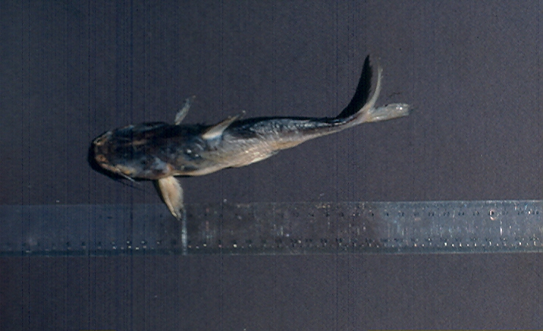
varwiker Va

Slide 36
varwiker VI
. use catfein
. warpdenm blfemin , b(3.9) m(10) k(6)
. varwiker blfemin, b(3.9)

Slide 37
varwiker VII
. varwiker blfemin, b(3.9)
. varwike2 blfemin, b(3.9) np(100)

Slide 38
Critical bandwidths I
In nonparametric assessment of multimodality by the smoothed bootstrap method proposed by Silverman (1981) is the precise determination of the last bandwidth value compatible with the hypothesis for a given number of modes (the critical bandwidth).
If this value is not precisely specified, the results of the test may not be correct.

Slide 39
Critical bandwidths II
Usually a simple binary search procedure can be used to find the critical bandwidths in practice (Silverman, 1986).
But our experience (with our algorithms) has shown that sometimes it is necessary to test for the number of modes a large collection of kde’s with gradually varying bandwidths.
This task may become monotone and time consuming even with the help of the Stata edition keys (as PageUp) which permit to repeat the commands and to change only the required parts.

Slide 40
Critical bandwidths III
This was the main motivation to write the critiband.ado file. This program repeats the kde calculation with a series of specified bandwidth values, counts the number of modes and reports the results.
As critiband.ado is essentially a loop for the warpdenm.ado program, shares almost all the options for the kde (warpdenm.ado) files and requires almost the same input.
It is important to note that in the search of critical bandwidths, we have found that a number of 30 or 40 shifted histograms is necessary to give reliable results.

Slide 41
Critical bandwidths IV
. critiband bodlen, bwh(23.5) bwl(23.1) st(.01) m(40)
Estimation number = 1 Bandwidth = 23.5 Number of modes = 1
Estimation number = 2 Bandwidth = 23.49 Number of modes = 1
Estimation number = 3 Bandwidth = 23.48 Number of modes = 1
Estimation number = 4 Bandwidth = 23.47 Number of modes = 1
Estimation number = 5 Bandwidth = 23.46 Number of modes = 2
Estimation number = 6 Bandwidth = 23.45 Number of modes = 1
Estimation number = 7 Bandwidth = 23.44 Number of modes = 1
Estimation number = 8 Bandwidth = 23.43 Number of modes = 1
Estimation number = 9 Bandwidth = 23.42 Number of modes = 2
Estimation number = 10 Bandwidth = 23.41 Number of modes = 1
Estimation number = 11 Bandwidth = 23.4 Number of modes = 1
Estimation number = 12 Bandwidth = 23.39 Number of modes = 1
Estimation number = 13 Bandwidth = 23.38 Number of modes = 1
Estimation number = 14 Bandwidth = 23.37 Number of modes = 1
Estimation number = 15 Bandwidth = 23.36 Number of modes = 1
Estimation number = 16 Bandwidth = 23.35 Number of modes = 2
Estimation number = 17 Bandwidth = 23.34 Number of modes = 2
Estimation number = 18 Bandwidth = 23.33 Number of modes = 2

Slide 42
Critical bandwidths V
. critiband bodlen, bwh(4) bwl(3.7) st(.01) m(40)
Estimation number = 1 Bandwidth = 4 Number of modes = 4
Estimation number = 2 Bandwidth = 3.99 Number of modes = 4
Estimation number = 3 Bandwidth = 3.98 Number of modes = 4
Estimation number = 4 Bandwidth = 3.97 Number of modes = 4
Estimation number = 5 Bandwidth = 3.96 Number of modes = 5
Estimation number = 6 Bandwidth = 3.95 Number of modes = 4
Estimation number = 7 Bandwidth = 3.94 Number of modes = 4
Estimation number = 8 Bandwidth = 3.93 Number of modes = 4
Estimation number = 9 Bandwidth = 3.92 Number of modes = 5
Estimation number = 10 Bandwidth = 3.91 Number of modes = 4
Estimation number = 11 Bandwidth = 3.9 Number of modes = 4
Estimation number = 12 Bandwidth = 3.89 Number of modes = 5
Estimation number = 13 Bandwidth = 3.88 Number of modes = 4
Estimation number = 14 Bandwidth = 3.87 Number of modes = 5
Estimation number = 15 Bandwidth = 3.86 Number of modes = 5
Estimation number = 16 Bandwidth = 3.85 Number of modes = 5
Estimation number = 17 Bandwidth = 3.84 Number of modes = 5
Estimation number = 18 Bandwidth = 3.83 Number of modes = 5
Estimation number = 19 Bandwidth = 3.82 Number of modes = 5
Estimation number = 20 Bandwidth = 3.81 Number of modes = 5
Estimation number = 21 Bandwidth = 3.8 Number of modes = 5
Estimation number = 22 Bandwidth = 3.79 Number of modes = 4
Estimation number = 23 Bandwidth = 3.78 Number of modes = 4
Estimation number = 24 Bandwidth = 3.77 Number of modes = 5
Estimation number = 25 Bandwidth = 3.76 Number of modes = 5
Estimation number = 26 Bandwidth = 3.75 Number of modes = 5

Slide 43
Critical bandwidths VI
. critiband bodlen, bwh(3.1) bwl(2.9) st(.01) m(40)
Estimation number = 1 Bandwidth = 3.1 Number of modes = 6
Estimation number = 2 Bandwidth = 3.09 Number of modes = 6
Estimation number = 3 Bandwidth = 3.08 Number of modes = 7
Estimation number = 4 Bandwidth = 3.07 Number of modes = 6
Estimation number = 5 Bandwidth = 3.06 Number of modes = 6
Estimation number = 6 Bandwidth = 3.05 Number of modes = 7
Estimation number = 7 Bandwidth = 3.04 Number of modes = 6
Estimation number = 8 Bandwidth = 3.03 Number of modes = 6
Estimation number = 9 Bandwidth = 3.02 Number of modes = 6
Estimation number = 10 Bandwidth = 3.01 Number of modes = 7
Estimation number = 11 Bandwidth = 3 Number of modes = 7
Estimation number = 12 Bandwidth = 2.99 Number of modes = 7
Estimation number = 13 Bandwidth = 2.98 Number of modes = 7
Estimation number = 14 Bandwidth = 2.97 Number of modes = 7
Estimation number = 15 Bandwidth = 2.96 Number of modes = 7
Estimation number = 16 Bandwidth = 2.95 Number of modes = 7
Estimation number = 17 Bandwidth = 2.94 Number of modes = 7
Estimation number = 18 Bandwidth = 2.93 Number of modes = 7
Estimation number = 19 Bandwidth = 2.92 Number of modes = 7
Estimation number = 20 Bandwidth = 2.91 Number of modes = 7
Estimation number = 21 Bandwidth = 2.9 Number of modes = 7

Slide 44
Silverman multimodality test (with bootsamb)
. use catfilen, clear
. set mem 32m
. keep bodlen
. set seed 220409
. boot bootsamb, ar(bodlen 23.36 49.5904) i(500)
warning: data in memory will be lost.
Press enter to continue, Ctrl-Break to abort.
(output ommited)
Contains data
obs: 320,500 bootsamb bootstrap
vars: 4
size: 6,410,000 (80.9% of memory free)
-------------------------------------------------------------------------
storage display value
variable name type format label variable label
-------------------------------------------------------------------------
_rep long %12.0g replication
bodlen float %9.0g
ysm float %9.0g
_obs long %12.0g observations
-------------------------------------------------------------------------
Sorted by:
Note: dataset has changed since last saved

Slide 45
Silverman multimodality test (with bootsamb) II
. silvtest ysm _rep, cr(23.36) m(40) nurf(500) cnm(1) nog
bs sample 1 Number of modes = 1
bs sample 2 Number of modes = 1
bs sample 3 Number of modes = 1
bs sample 4 Number of modes = 1
bs sample 5 Number of modes = 1
.
.
.
bs sample 497 Number of modes = 1
bs sample 498 Number of modes = 1
bs sample 499 Number of modes = 1
bs sample 500 Number of modes = 1
Critical number of modes = 1
P value = 0 / 500 = 0.0000

Slide 46
Silverman multimodality test (with bootsamb) III
. silvtest ysm _rep, cr(3.78) m(40) nurf(500) cnm(4) nog
bs sample 1 Number of modes = 6
bs sample 2 Number of modes = 5
bs sample 3 Number of modes = 4
bs sample 4 Number of modes = 4
bs sample 5 Number of modes = 5
.
.
.
bs sample 497 Number of modes = 4
bs sample 498 Number of modes = 4
bs sample 499 Number of modes = 5
bs sample 500 Number of modes = 6
Critical number of modes = 4
P value = 383 / 500 = 0.7660

Slide 47
Silverman multimodality test (with bootsamb) IV
Critical bandwidths and significance levels estimated for Cathorops melanopus standard body length data (n = 641)
Number of modes | Critical bandwidths | P value
1 | 23.36 | 0.0000
2 | 19.43 | 0.0000
3 | 9.64 | 0.1560
4 | 3.78 | 0.7660
5 | 3.23 | 0.8140
6 | 3.02 | 0.6780
Nota: P values obtained from B = 500 bootstrap repetitions of size 641

Slide 48
Silverman multimodality test (with bootsamb) V
. use catfilen, clear
. di (9.63+3.78)/2
6.705
. warpdenm bodlen, b(6.7) m(10) k(6) numo mo
Number of modes = 4
________________________________________________________
Modes in WARPing density estimation, bw = 6.7, M = 10, Ker = 6
---------------------------------------------------------------------------
Mode ( 1 ) = 77.7200
Mode ( 2 ) = 136.6800
Mode ( 3 ) = 174.2000
Mode ( 4 ) = 214.4000
________________________________________________________

Slide 49
Silverman multimodality test (with bootsamb) VI

Slide 50
Some final considerations
Density traces mainly of historical interest
Bandwidth rules as educated reference values (good starting point for further analysis)
Variable width kernel density estimation source of new developments (combination with Silverman multimodality test)
Nonparametric assessment of multimodality with smoothed bootstrap procedure as a source of new programming developments
Overall a collection of very simple programs, but very useful

Slide 51


Books with the procedures presented

