Slide 1
Using Mata to Import Illumina SNP Chip Data For Genome-Wide
Association Studies
Stata Conference London 2011
September 16, 2011
John Charles “Chuck” Huber Jr, PhD
Associate Professor of Biostatistics
Department of Epidemiology and Biostatistics
School of Rural Public Health
Texas A&M Health Science Center
jchuber@tamu.edu

Slide 2
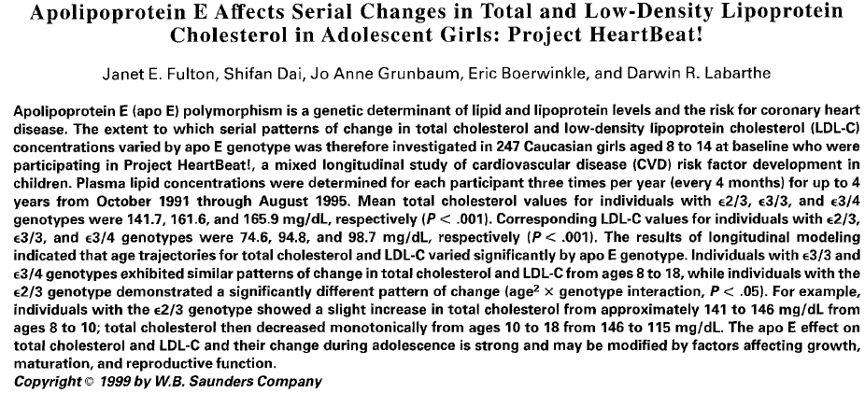
Motivation – Project Heartbeat!
Reference: Fulton, JE, Dai, S, Grunbaum, JA, Boerwinkle, E, Labarthe, R (1999) Apolipoprotein E affects serial changes
In total and low-density lipoprotein cholesterol in adolescent girls: Project Heartbeat!. Metabolism 48(3): 285-290

Slide 3
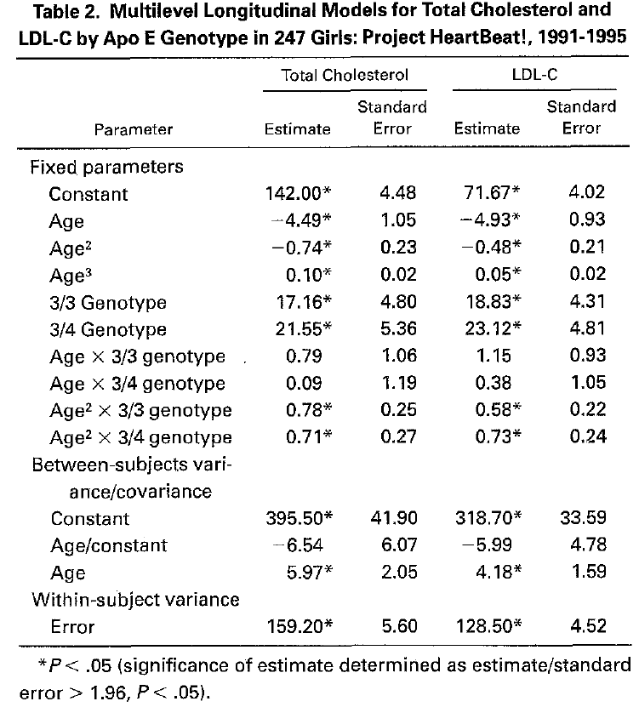
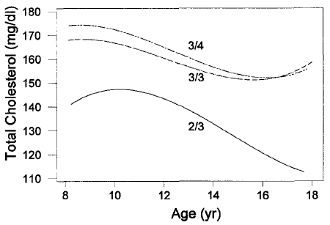
Motivation
Reference: Fulton, JE, Dai, S, Grunbaum, JA, Boerwinkle, E, Labarthe, R (1999) Apolipoprotein E affects serial changes
In total and low-density lipoprotein cholesterol in adolescent girls: Project Heartbeat!. Metabolism 48(3): 285-290

Slide 4
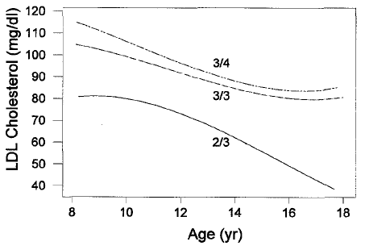
Motivation
Reference: Fulton, JE, Dai, S, Grunbaum, JA, Boerwinkle, E, Labarthe, R (1999) Apolipoprotein E affects serial changes
In total and low-density lipoprotein cholesterol in adolescent girls: Project Heartbeat!. Metabolism 48(3): 285-290

Slide 5
Motivation
Human genetics studies in the 1990s tended to focus on family data – Project Heartbeat! was a population-based study (no relatives)
Genetic studies of unrelated individuals became popular in the 2000s
Genetic markers called Single Nucleotide Polymorphisms (SNPs) became cheap to ascertain on a very large scale

Slide 6
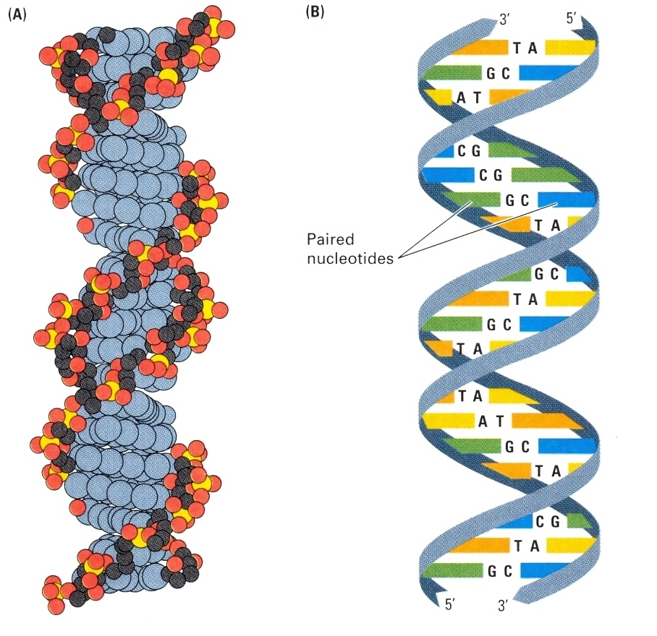
What is a SNP?
Hartl & Jones (1998) pg 9, Figure 1.5

Slide 7
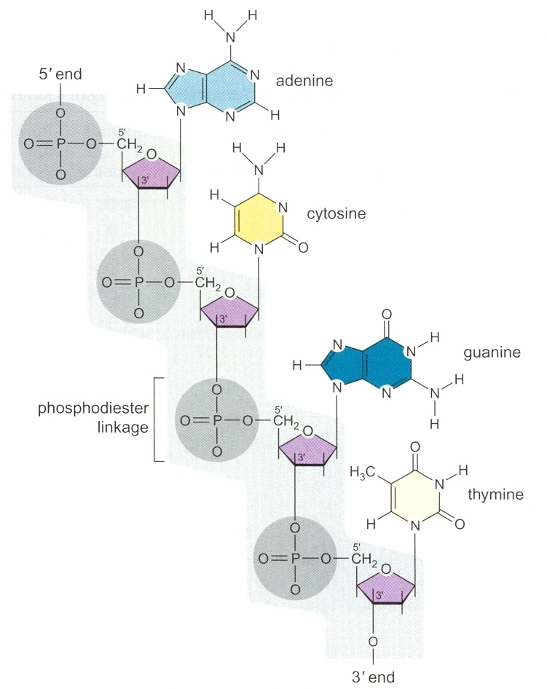
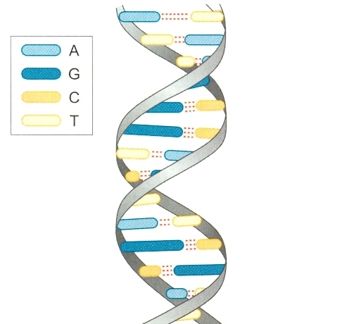
What is a SNP?
Watson et al. (2004) pg 23, Figure 2.5

Slide 8
What is a SNP?
A SNP is a single nucleotide polymorphism (the individual nucleotides are called alleles)
ataagtcgatactgatgcatagctagctgactgacgcgat ataagtccatactgatgcatagctagctgactgaagcgat
    ataagtccatactgatgcatagctagctgactgacgcgat
    ataagtcgatactgatgcatagctagctgactgaagcgat
Person 1 – Chromosome 1
Person 1 – Chromosome 2
Person 2 – Chromosome 1
Person 2 – Chromosome 2
SNP1
SNP2

Slide 9
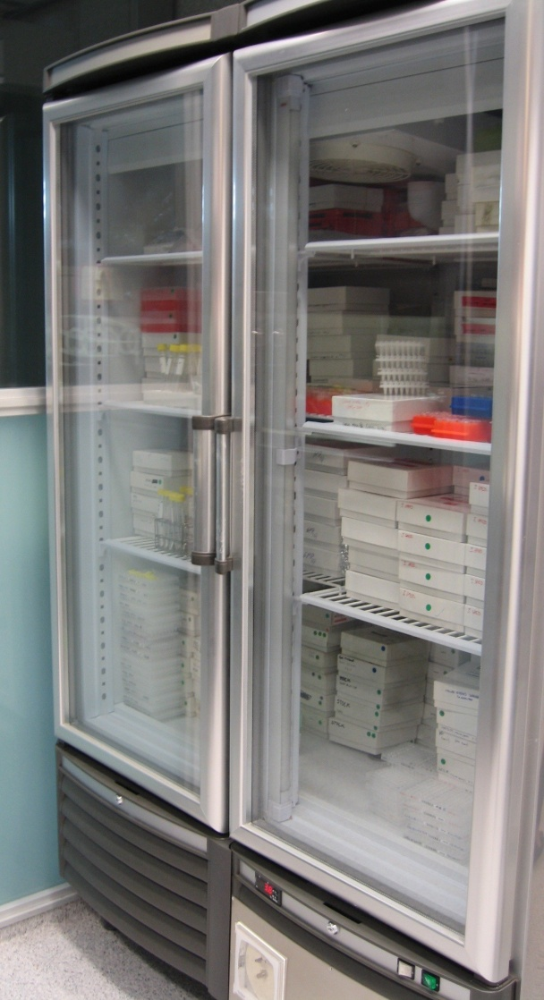
Motivation
Stored Genotype Data
  Blood samples and DNA available for 131 African-American and 505 non-Hispanic white children between 8 and 17 years of age.

Slide 10
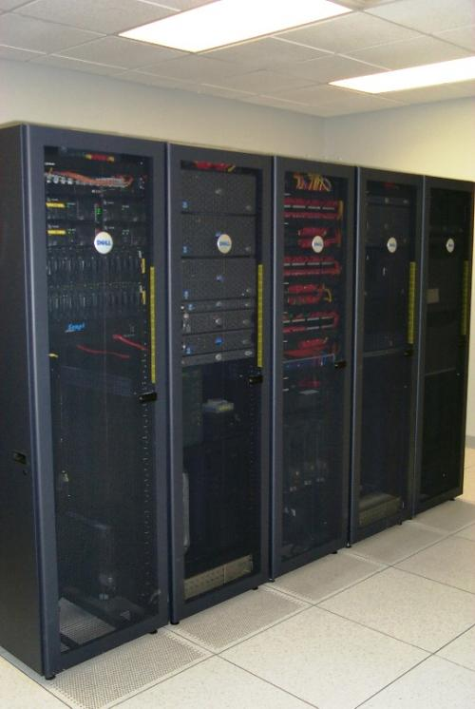
Motivation
Stored Phenotype Data
Longitudinal measurements of:
Body Mass Index
Total Cholesterol
HDL & LDL Cholesterol
Systolic and Diastolic BP
Much, much more…..

Slide 11

Motivation
Let’s go gene hunting!!!

Slide 12

Challenges
Longitudinal Data – (can’t use PLINK or HelixTree)
Specialized genetic data analysis
Need to run a very large number of models
Multiple comparisons and replication
Scaling up to 100,000 SNP Chips

Slide 13

Scaling up to 100,000 SNPs
HELP!

Slide 14
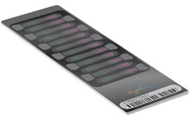
IlluminaCVD BeadChip
“The HumanCVD BeadChip is the first high-density single nucleotide polymorphism (SNP) genotyping standard panel specifically targeted for cardiovascular disease (CVD) studies. The BeadChip features nearly 50,000 SNPs that capture genetic diversity across approximately 2,100 genes associated with CVD processes such as blood pressure changes, insulin resistance, metabolic disorders, dyslipidemia, and inflammation.”
Source: http://www.illumina.com/products/humancvd_whole_genome_genotyping_kits.ilmn

Slide 15
Illumina Metabochip
The “Metabochip” is a popular “iSelect” BeadChip
Panel of 200,000 SNPs
Focus on SNPs in genes related to general metabolism, diabetes and cardiovascular disease
Source: http://www.illumina.com/applications/detail/snp_genotyping_and_cnv_analysis/custom_mid_to_high_plex_genotyping.ilmn

Slide 16
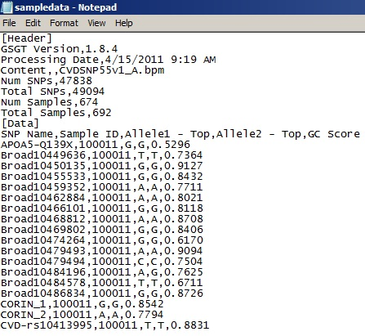
The CVD BeadChip Data
Header Information
Person 1, SNP 1
Person 1, SNP 50,000
Person 2, SNP 1
Person 2, SNP 50,000
Person 674, SNP 1
Person 674, SNP 50,000
674 x 50,000 = 33,700,000 lines!!!

Slide 17
The Metabochip Data
Header Information
Person 1, SNP 1
Person 1, SNP 200,000
Person 2, SNP 1
Person 2, SNP 200,000
Person 674, SNP 1
Person 674, SNP 200,000
674 x 200,000 = 134,800,000 lines!!!

Slide 18
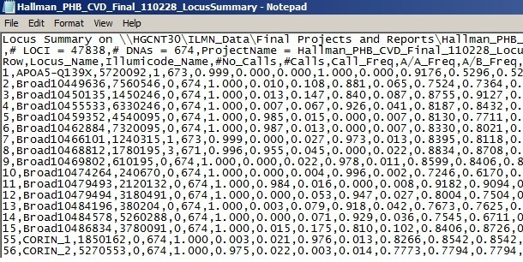
Meta-Data About SNPs
50,000 lines
Or
200,000 lines
We also have metadata such as quality control information about each SNP. Ideally, we would like to import this into our dataset.

Slide 19
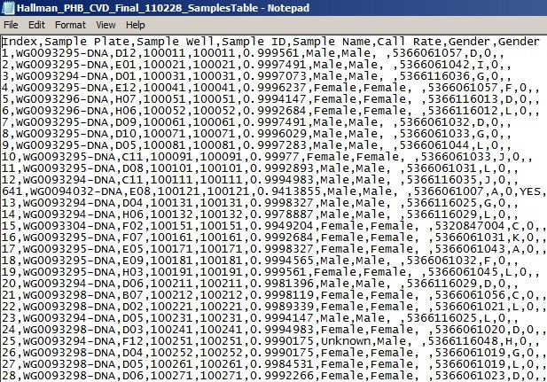
Meta-Data About Participants
674 Lines
We also have metadata about each participant. It would be nice to import this into our dataset also.

Slide 20
How do we put it all together?!?
Question
How do we sift through tens of millions of records across three files in a reasonable amount of time and gather the information into a useful Stata dataset?

Slide 21
ImportIllumina
// EXAMPLE SYNTAX:
local SnpList "rs1000113 rs1000115 rs10001190 rs10002186 rs10002743“
local DataFile "Hallman_PHB_CVD_Final_110228_GenotypingReport.csv"
local MarkerFile "Hallman_PHB_CVD_Final_110228_LocusSummary.csv“
local SampleFile "Hallman_PHB_CVD_Final_110228_SamplesTable.csv“
ImportIllumina `SnpList', datafile(`DataFile') snpfile(`MarkerFile') samplefile(`SampleFile')

Slide 22
Software Limits
“infix” and “infile” won’t work because we would exceed the limit of 32,767 variables.
But we can import over 2 billion records and if we are clever, we could parse the data into separate files perhaps by chromosome.
Maximum size limits
Stata/MP and
Small Stata/IC Stata/SE
---------------------------------------------------------------------------------------
# of observations (1) 1,200 2,147,483,647 2,147,483,647
# of variables 99 2,047 32,767
width of a dataset in bytes 800 24,564 393,192
value of matsize 100 800 11,000

Slide 23
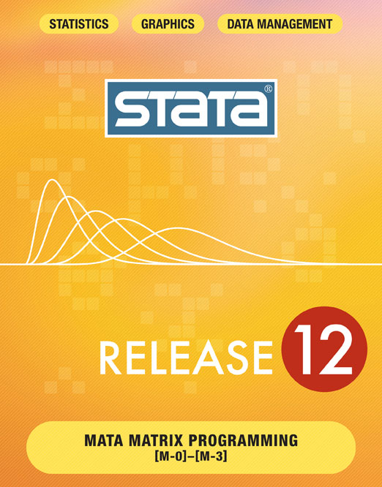
Answer: Mata!
Introduction to Mata
“Mata is a full-blown programming language that compiles what you type into byte-code, optimizes it, and executes it fast. Behind the scenes, many of Stata’s commands are implemented using Mata. You can use Mata to implement big systems, or you can use it interactively.”
Source: http://stata.com/whystata/intromata.html

Slide 24
Features of Mata
Has low level file Input/Output capabilities
Can store strings in matrices
Can tokenize lists
Can create variables in Stata datasets
Can modify data in Stata datasets
Can pass macros back-and-forth with Stata
Can execute Stata commands from within Mata
Can Pass datasets back-and-forth with Stata

Slide 25
Biggest Advantage of Mata
But most importantly –
Mata is very, very fast!

Slide 26
Disclaimer
I am, at best, a novice Mata programmer so the following code is meant to show “A” way to do something but certainly not “THE” way to do something.

Slide 27
String Matrices in Mata
Program
mata
SnpData = ("100011", "G/G", "G/G" \ "100021" , "G/G", "A/G" \ "100031", "G/G", "A/G")
SnpData
end
Result
. mata
-------------------------- mata (type end to exit) -----------------------------------------
: SnpData = ("100011", "G/G", "G/G" \ "100021" , "G/G", "A/G" \ "100031", "G/G", "A/G")
: SnpData
1 2 3
+----------------------------+
1 | 100011 G/G G/G |
2 | 100021 G/G A/G |
3 | 100031 G/G A/G |
+----------------------------+
: end

Slide 28
Mata File I/O
Program
mata // INITIATE MATA SESSION
fh1 = fopen(SampleFilename, "r") // OPEN THE ASCII FILE
TempLine = fget(fh1) // READ A LINE FROM THE FILE
TempLine // DISPLAY THE LINE FROM THE FILE
TempLine = fget(fh1) // READ THE NEXT LINE
TempLine // DISPLAY THE LINE FROM THE FILE
fclose(fh1) // CLOSE THE ASCII FILE
end // END MATA SESSION
Result
. mata // INITIATE MATA SESSION
----------------------------------- mata (type end to exit) ----------------------------------
: fh1 = fopen("sampledata.txt", "r") // OPEN THE ASCII FILE
: TempLine = fget(fh1) // READ A LINE FROM THE FILE
: TempLine // DISPLAY THE LINE FROM THE FILE
[Header]
: TempLine = fget(fh1) // READ THE NEXT LINE
: TempLine // DISPLAY THE LINE FROM THE FILE
GSGT Version,1.8.4
: fclose(fh1) // CLOSE THE ASCII FILE
: end // END MATA SESSION

Slide 29
Mata Tokenize
Program
mata
snps = “snp1,snp2,snp3"
t = tokeninit(",") // IDENTIFY THE PARSING CHARACTER
tokenset(t,snps) // USE RULE DEFINED IN "t" TO TOKENIZE “snps"
TokenSnps = tokengetall(t) // STORE ALL OF THE TOKENS TO "TokenSnps"
TokenSnps[1] // VIEW THE FIRST TOKEN
TokenSnps[2] // VIEW THE SECOND TOKEN
TokenSnps[3] // VIEW THE THIRD TOKEN
end
Result
. mata
------------------------------------- mata (type end to exit) -------------------------------------------
: snps = “snp1,snp2,snp3“
: t = tokeninit(",") // IDENTIFY THE PARSING CHARACTER
: tokenset(t,snps) // USE RULE DEFINED IN "t" TO TOKENIZE “snps“
: TokenSnps = tokengetall(t) // STORE ALL OF THE TOKENS TO “snps“
: TokenSnps[1] // VIEW THE FIRST TOKEN
snp1
: TokenSnps[2] // VIEW THE SECOND TOKEN
snp2
: TokenSnps[3] // VIEW THE THIRD TOKEN
snp3
: end

Slide 30
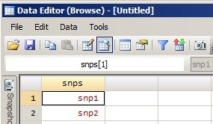
Variables: Mata to Stata
Program
clear
mata
st_addvar("str10",“snps") // ADD A NEW VARIABLE CALLED “snps"
st_addobs(1) // APPEND A NEW OBSERVATION TO STATA
st_sstore(st_nobs(),“snps",“snp1") // STORE “snp1" TO THE VARIABLE “snps"
st_addobs(1) // APPEND A NEW OBSERVATION TO STATA
st_sstore(st_nobs(),“snps",“snp2") // STORE “snp2" TO THE VARIABLE “snps"
end
Result

Slide 31
Local Macros: Mata to Stata
Program
mata
SnpListStata = "snp1 snp2 snp3" // DEFINE A VARIABLE IN MATA
st_local("SnpListStata", SnpListMata) // SENS THE LOCAL MACRO IN STATA
end
disp "The SNPs in the list are: `SnpListStata'"
Result
. mata
--------------- mata (type end to exit) --------------------------------
: SnpListStata = "snp1 snp2 snp3" // DEFINE A VARIABLE IN MATA
: st_local("SnpListStata", SnpListMata) // SENS THE LOCAL MACRO IN STATA
: end
-------------------------------------------------------------------------
. disp "The SNPs in the list are: `SnpListStata'"
The SNPs in the list are: snp1 snp2 snp3

Slide 32
Local Macros: Stata to Mata
Program
local SnpListStata "snp1 snp2 snp3" // DEFINE A LOCAL MACRO IN STATA
mata
SnpListMata = st_local("SnpListStata") // GRAB THE LOCAL MACRO IN MATA
SnpListMata
end
Result
. local SnpListStata "snp1 snp2 snp3"
. mata
------------------------- mata (type end to exit) -----------------------
: SnpListMata = st_local("SnpListStata")
: SnpListMata
snp1 snp2 snp3
: //st_local("SnpListMata", SnpListStata)
:
: end

Slide 33
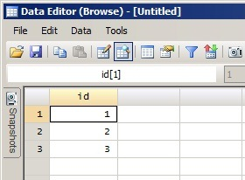
Stata Commands in Mata
Program
mata
void function TempFunc() {
stata("clear")
stata("set obs 3")
stata("gen id = [_n]")
}
end
Result

Slide 34
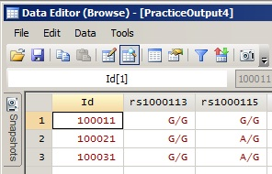
Stata to Mata: putmata
Program
putmata Id rs1000113 rs1000115
mata
Id
rs1000113
end
Result
. mata
-------------------------- mata (type end to exit) -----------------------------------------------
: Id
1
+----------+
1 | 100011 |
2 | 100021 |
3 | 100031 |
+----------+
: rs1000113
1
+-------+
1 | G/G |
2 | G/G |
3 | G/G |
+-------+
: end

Slide 35
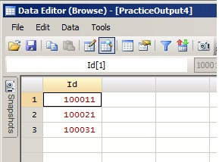
Mata to Stata: getmata
drop rs1000113 rs1000115
getmata rs1000113 rs1000115, id(Id)

Slide 36
Variable “Characteristics”
Sometimes we would like to store “meta-data” or “characteristics” about our variables. This is easily done in Stata with the “char” command:
* EXAMPLE OF HOW TO ADD CHARACTERISTICS TO A VARIABLE AND EXTRACT THEM TO A LOCAL MACRO
char SNP1[chromosome] 7
char SNP1[gene] Gene1
char SNP1[position] 142702852
local TempChromosome : char SNP1[chromosome]
local TempGene : char SNP1[gene]
local TempPosition : char SNP1[position]
. disp "SNP1 is on Chromosome `TempChromosome', in `TempGene' at position `TempPosition'"
SNP1 is on Chromosome 7, in Gene1 at position 142702852

Slide 37
ImportIllumina
// EXAMPLE SYNTAX:
local SnpList "rs1000113 rs1000115 rs10001190 rs10002186 rs10002743“
local DataFile "Hallman_PHB_CVD_Final_110228_GenotypingReport.csv"
local MarkerFile "Hallman_PHB_CVD_Final_110228_LocusSummary.csv“
local SampleFile "Hallman_PHB_CVD_Final_110228_SamplesTable.csv“
ImportIllumina `SnpList', datafile(`DataFile') snpfile(`MarkerFile') samplefile(`SampleFile')

Slide 38
ImportIllumina
Rough Sketch of Code for ImportIllumina:
Stata program syntax {
Mata function to import raw data
Mata function to import and merge participant QC data
Mata function to import SNP QC data and place it in variable characteristics
Stata “housekeeping” code
}

Slide 39
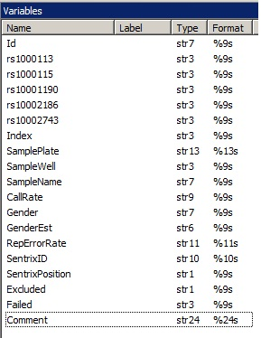
ImportIllumina - Output

Slide 40
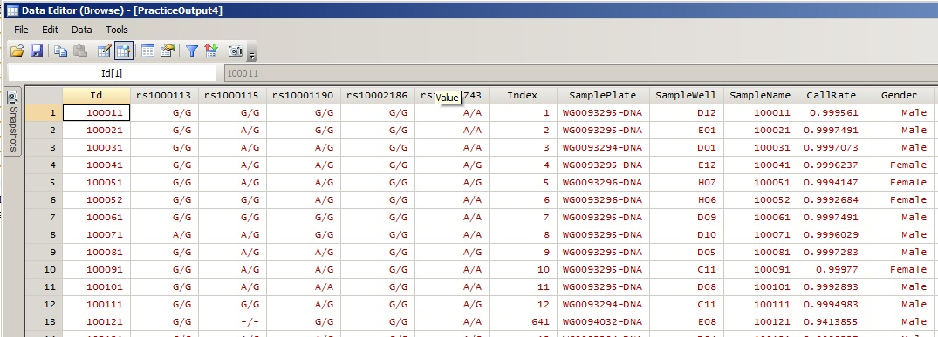
ImportIllumina - Output

Slide 41
ImportIllumina - Output
. char list rs1000113[]
rs1000113[note1]: possibly carried fwd
rs1000113[note0]: 1
rs1000113[Row]: 129
rs1000113[Locus_Name]: rs1000113
rs1000113[Illumicode_Name]: 1010142
rs1000113[No_Calls]: 0
rs1000113[Calls]: 674
rs1000113[Call_Freq]: 1.000
rs1000113[AA_Freq]: 0.018
rs1000113[AB_Freq]: 0.177
rs1000113[BB_Freq]: 0.806
rs1000113[Minor_Freq]: 0.106
rs1000113[Gentrain_Score]: 0.8266
rs1000113[GC50_Score]: 0.8542
rs1000113[GC10_Score]: 0.8542
rs1000113[Het_Excess_Freq]: -0.0691
rs1000113[ChiTest_P100]: 0.4897
rs1000113[Cluster_Sep]: 0.9035
rs1000113[AA_T_Mean]: 0.022
rs1000113[AA_T_Std]: 0.016
rs1000113[AB_T_Mean]: 0.631
rs1000113[AB_T_Std]: 0.032
rs1000113[BB_T_Mean]: 0.984
rs1000113[BB_T_Std]: 0.007
rs1000113[AA_R_Mean]: 1.002
rs1000113[AA_R_Std]: 0.109
rs1000113[AB_R_Mean]: 1.178
rs1000113[AB_R_Std]: 0.130
rs1000113[BB_R_Mean]: 1.076
rs1000113[BB_R_Std]: 0.100

Slide 42
ImportIllumina - Output
. char list rs1000115[]
rs1000115[note1]: possibly carried fwd
rs1000115[note0]: 1
rs1000115[Row]: 130
rs1000115[Locus_Name]: rs1000115
rs1000115[Illumicode_Name]: 6400181
rs1000115[No_Calls]: 1
rs1000115[Calls]: 673
rs1000115[Call_Freq]: 0.999
rs1000115[AA_Freq]: 0.131
rs1000115[AB_Freq]: 0.474
rs1000115[BB_Freq]: 0.395
rs1000115[Minor_Freq]: 0.368
rs1000115[Gentrain_Score]: 0.7572
rs1000115[GC50_Score]: 0.7449
rs1000115[GC10_Score]: 0.7449
rs1000115[Het_Excess_Freq]: 0.0193
rs1000115[ChiTest_P100]: 0.8470
rs1000115[Cluster_Sep]: 0.6517
rs1000115[AA_T_Mean]: 0.035
rs1000115[AA_T_Std]: 0.012
rs1000115[AB_T_Mean]: 0.579
rs1000115[AB_T_Std]: 0.054
rs1000115[BB_T_Mean]: 0.979
rs1000115[BB_T_Std]: 0.008
rs1000115[AA_R_Mean]: 1.708
rs1000115[AA_R_Std]: 0.278
rs1000115[AB_R_Mean]: 1.870
rs1000115[AB_R_Std]: 0.266
rs1000115[BB_R_Mean]: 1.523
rs1000115[BB_R_Std]: 0.172

Slide 43
Data checking with the “snpsumm” command:
. snpsumm rs1000113 rs1000115 rs10001190 rs10002186 rs10002743, listhw missing("?/?") separator("/")
Hardy-Weinberg Equilibrium Information
=================================================================
maf is the Minor Allele Frequency
hw_c2 is the Pearson Chi-squared
hw_c2p is the Pearson Chi-Squared p-value
hw_lr is the Likelihood Ratio Chi-squared
hw_lrp is the Likelihood Ratio Chi-Squared p-value
hw_ex is the Exact p-value
=================================================================
+-------------------------------------------------------------------+
| Marker maf hw_c2 hw_c2p hw_lr hw_lrp hw_ex |
|-------------------------------------------------------------------|
1. | rs1000113 0.0746 10.44 0.0012 9.05 0.0026 0.0024 |
2. | rs1000115 0.1022 4223.77 0.0000 154.65 0.0000 . |
3. | rs10001190 0.3342 0.52 0.4702 0.52 0.4706 0.4678 |
4. | rs10002186 . . . . . . |
5. | rs10002743 0.3439 4226.53 0.0000 133.11 0.0000 . |
+-------------------------------------------------------------------+

Slide 44
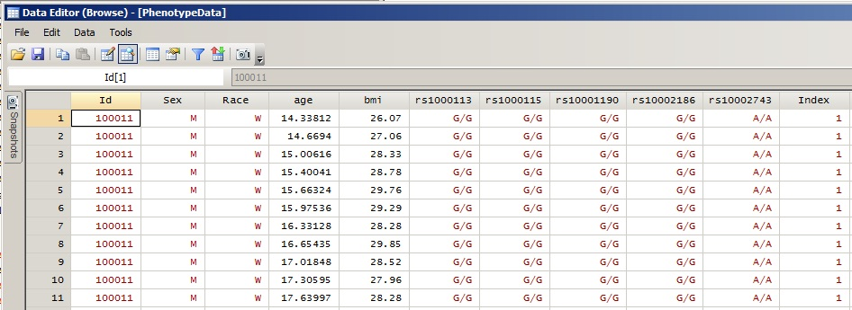
Merge Phenotype and Genotype Data

Slide 45
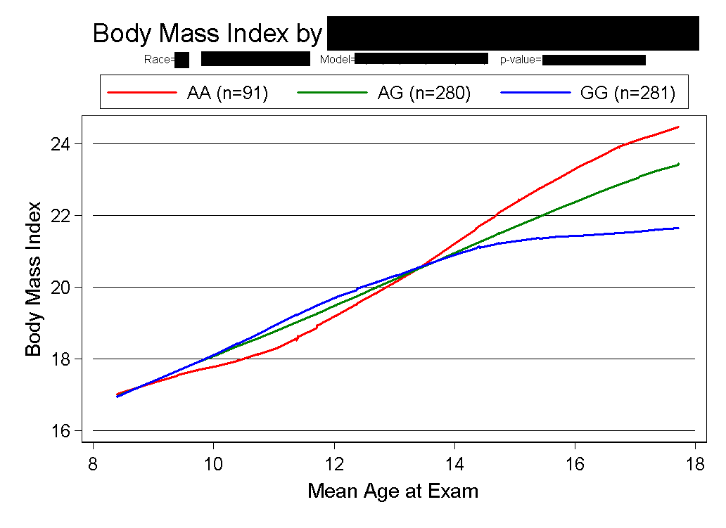
Actual Analysis
Lowess curve of BMI over age

Slide 46
Summary
  Mata is a very useful and fast programming environment for low-level file I/O and large-scale string manipulation!
  ImportIllumina is still in beta-testing but will be submitted to the
  Stata Journal soon.

Slide 47
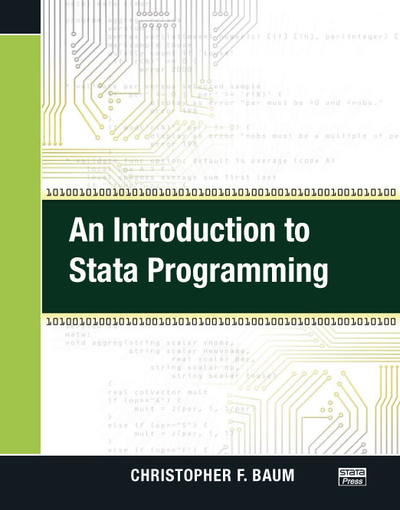
An Introduction to Stata Programming by Christopher Baum
Table of Contents
Why should you become a Stata programmer?
Some elementary concepts and tools
Do-file programming: Functions, macros, scalars, and matrices
Cookbook: Do-file programming I
Do-file programming: Validation, results, and data management
Cookbook: Do-file programming II
Do-file programming: Prefixes, loops, and lists
Cookbook: Do-file programming III
Do-file programming: Other topics
Cookbook: Do-file programming IV
Ado-file programming
Cookbook: Ado-file programming
Mata functions for ado-file programming
Cookbook: Mata function programming

Slide 48
Co-Authors
Michael Hallman, PhD (Principal Investigator)
Victoria Friedel, MA
Melissa Richard, MS
Huandong Sun
  All at University of Texas School of Public Health

Slide 49
Acknowledgements
Grant 1-R01DK073618-02 from the National Institute of Diabetes and Digestive and Kidney Diseases
Michael Hallman, PhD
  Assistant Professor of Epidemiology, UTSPH-Houston
Eric Boerwinkle, PhD
  Professor and Director of the Division of Epidemiology
  Kozmetsky Family Chair in Human Genetics, UTSPH-Houston
Darwin Labarthe, MD, PhD, MPH
  Director of the Division for Heart Disease and Stroke Prevention, CDC-Atlanta

